Slide 1
Forcing the Compiler to Generate Jump Tables
Lennox Shou Hao Ho
lennox.ho@intel.com

Slide 2
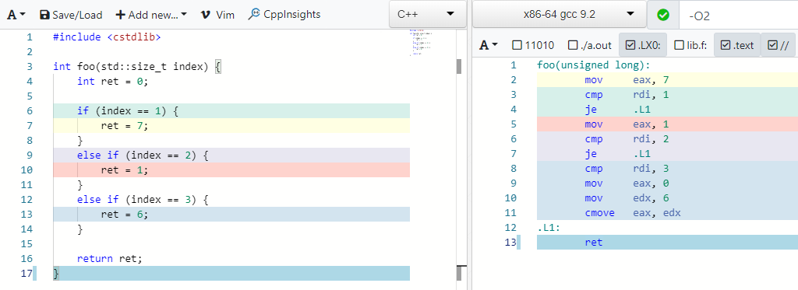
A Trivial Example

Slide 3
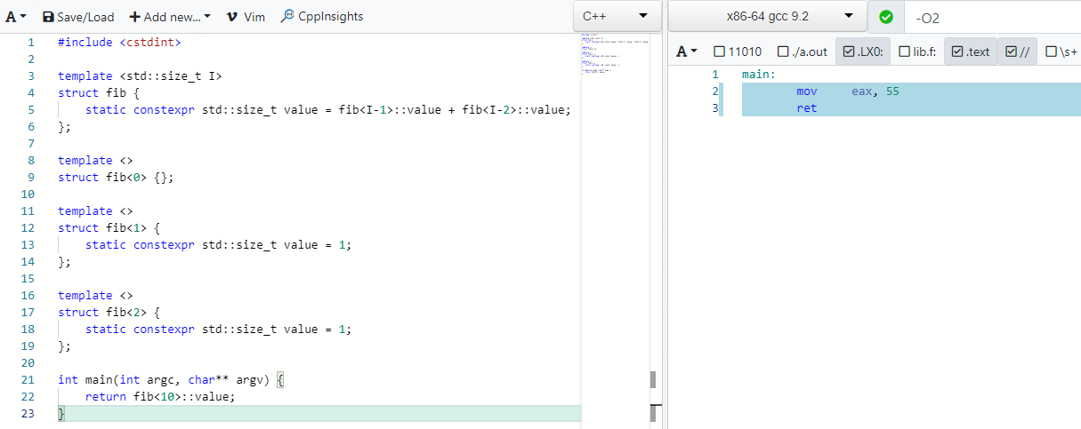
But First, Automatically Generate if-else cases

Slide 4
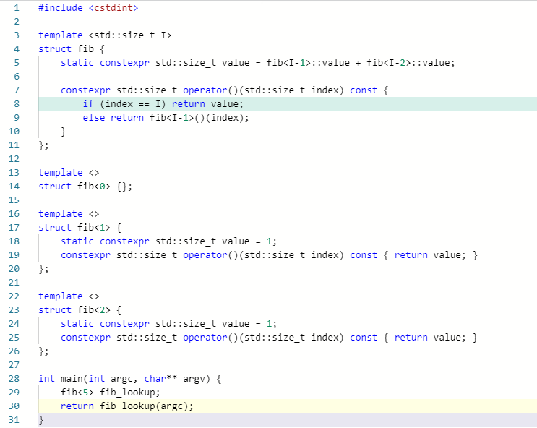
But First, Automatically Generate if-else cases

Slide 5
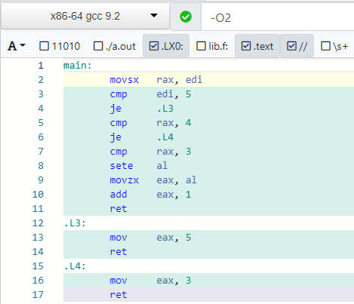
Fibonacci : 5 numbers

Slide 6
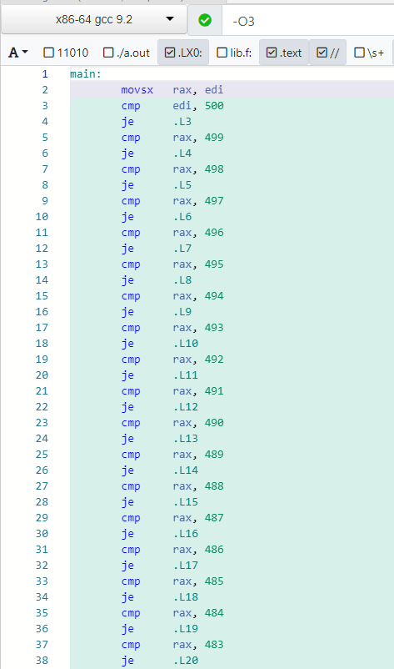
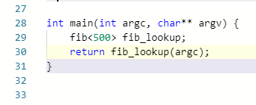
Fibonacci : 500 numbers

Slide 7
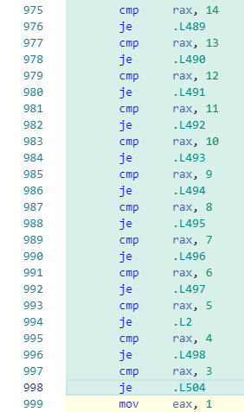
Fibonacci : 500 numbers

Slide 8
More Practical Problem : Jump Table + Variant Visit
Currently all major implementations of Variant classes (std::variant, boost::variant, boost::variant2) perform linear lookup
This is generally fine, until N is large and/or the visitor function is non-trivial
Want the choice to use jump tables if we so choose

Slide 9
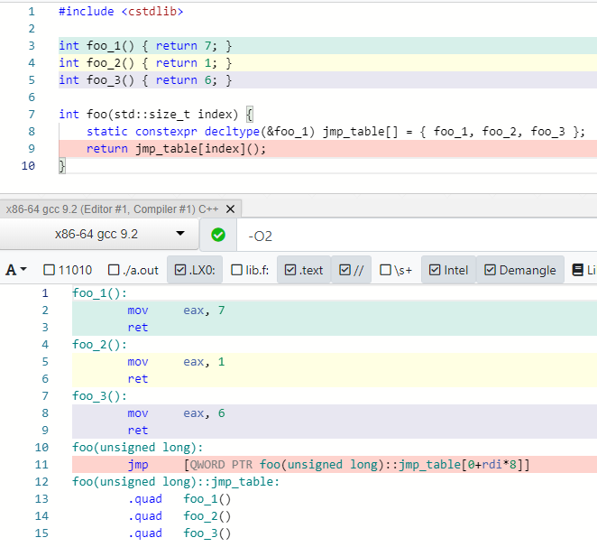
How to Generate Jump Table? Basic Observation

Slide 10

Use Function Template to Generate Callbacks
std::get can take an index

Slide 11
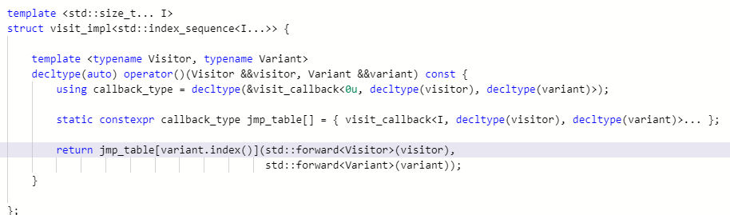
Use Variadic Template to Generate Indices

Slide 12
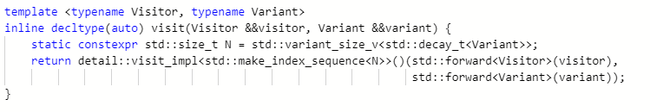
Get Variant Size

Slide 13
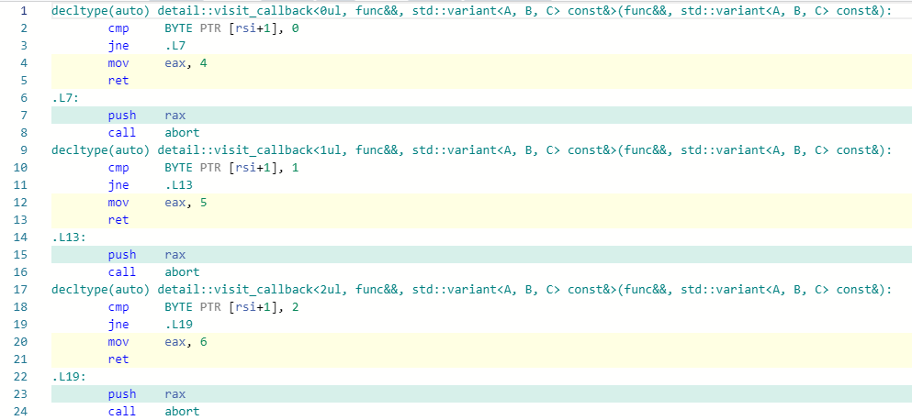
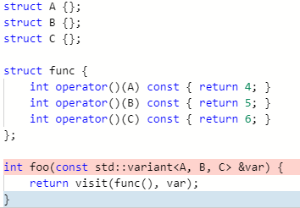
Generated ASM

Slide 14
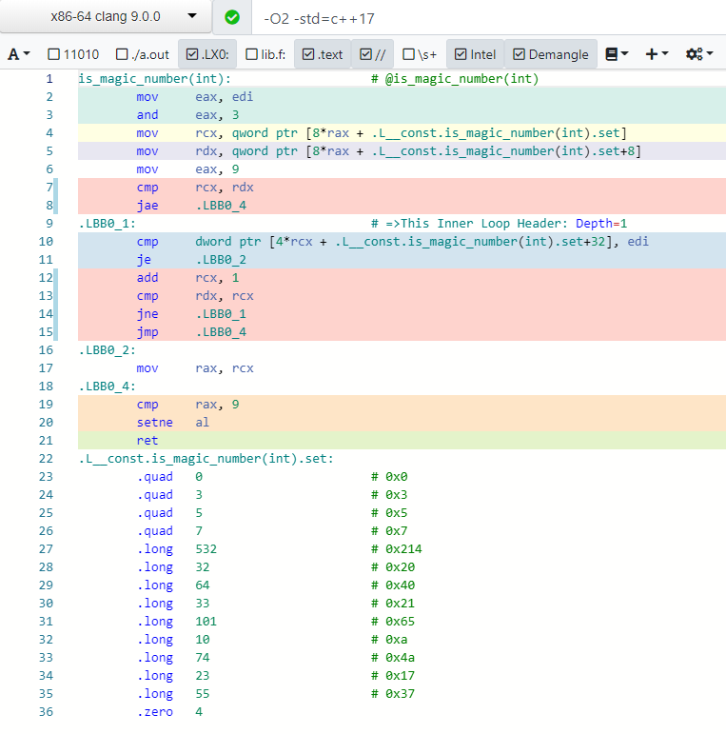
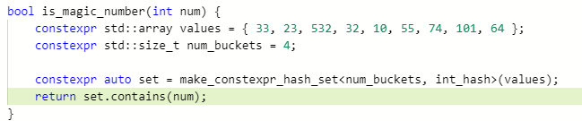
Sneak Peek – constexpr hash map/set

